Slide 1
3D Motion Estimation

Slide 2
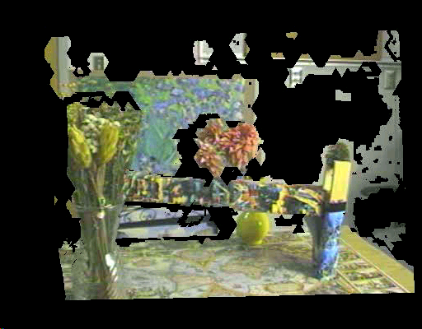
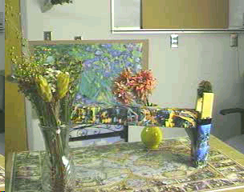
3D model construction

Slide 3
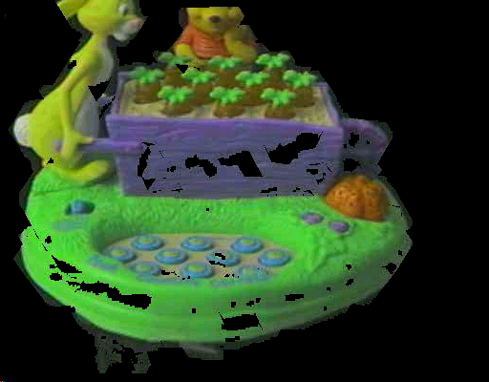
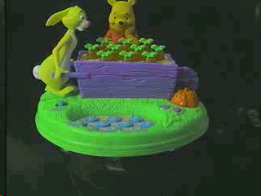
3D model construction

Slide 4
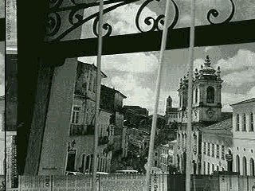
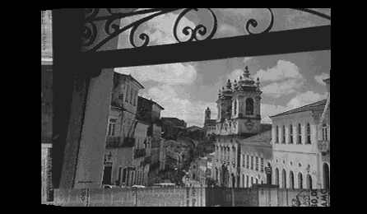
Video Manipulation

Slide 5
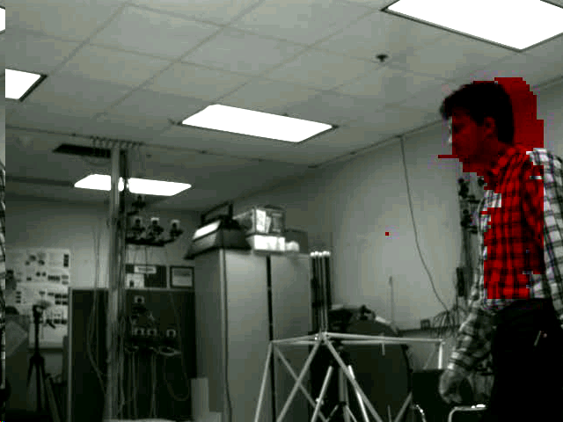

Slide 6
Visual Motion
Allows us to compute useful properties of the 3D world, with very little knowledge.
Example: Time to collision

Slide 7
Time to Collision
An object of height L moves with constant velocity v:
At time t=0 the object is at:
  D(0) = D_{o}
At time t it is at
  D(t) = D_{o} – vt
It will crash with the camera at time:
  D(τ) = D_{o} – vτ = 0
  τ = D_{o}/v
v
L
L
l(t)
f
t
t=0
D_{o}
D(t)

Slide 8
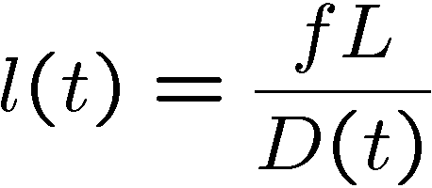
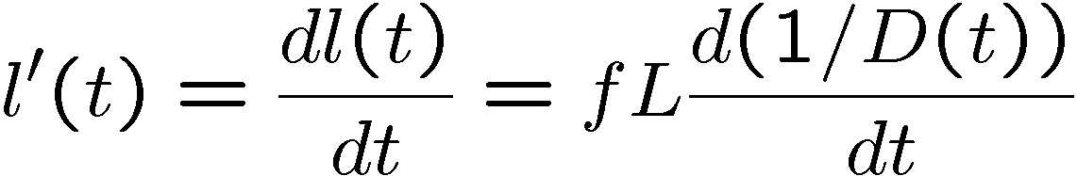
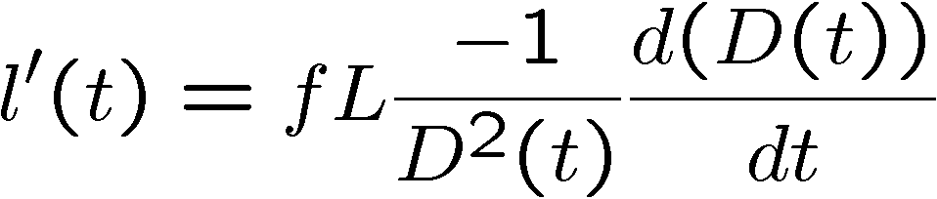
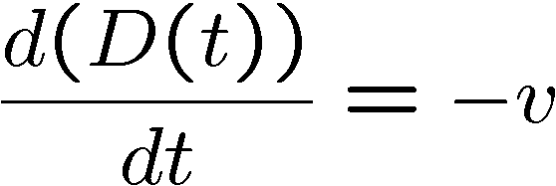
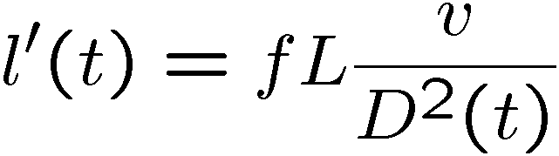
Time to Collision
The image of the object has size l(t):
v
L
L
l(t)
Taking derivative wrt time:
f
t
t=0
D_{o}
D(t)

Slide 9
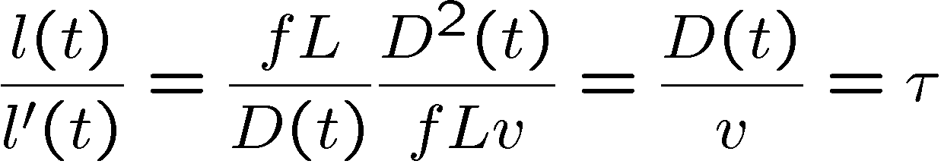
Time to Collision
v
L
L
l(t)
f
t
t=0
D_{o}
And their ratio is:
D(t)

Slide 10
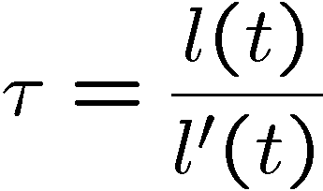
Time to Collision
v
Can be directly measured from image
L
L
l(t)
f
t
t=0
D_{o}
And time to collision:
D(t)
Can be found, without knowing L or D_{o} or v !!

Slide 11
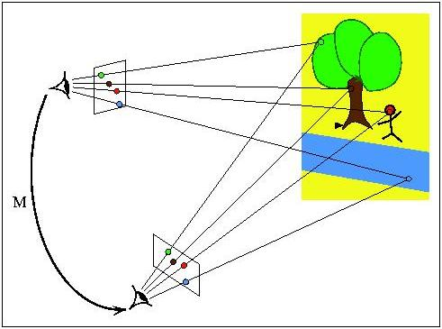

Slide 12
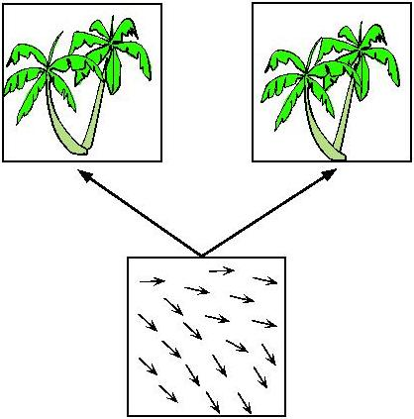

Slide 13
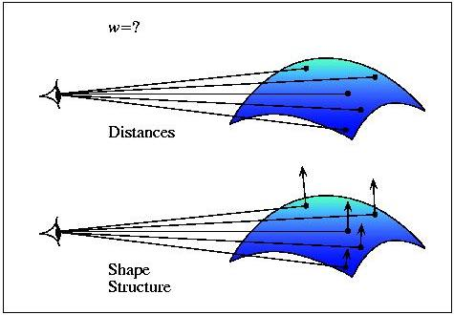

Slide 14
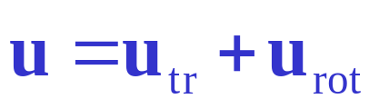
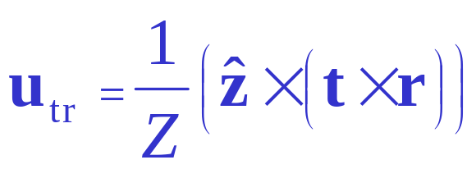
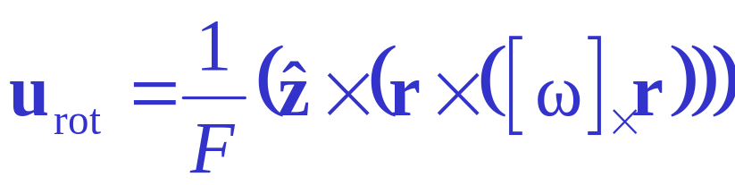
Structure from Motion
Z
r
u
t, ω

Slide 15
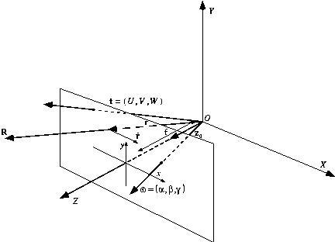
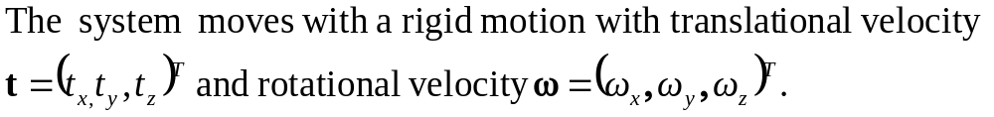

Passive Navigation and Structure from Motion

Slide 16
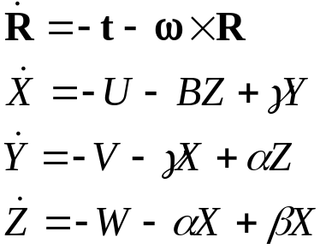
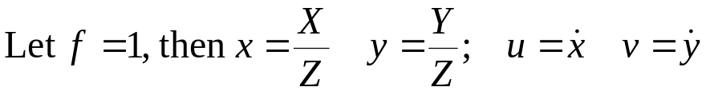
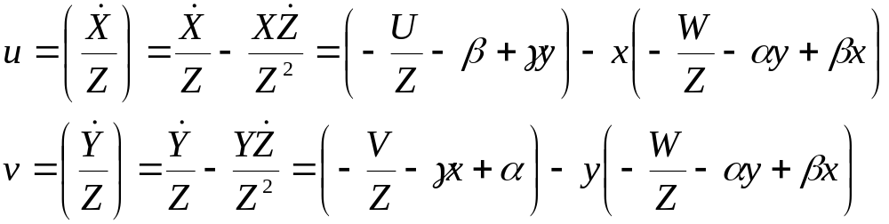
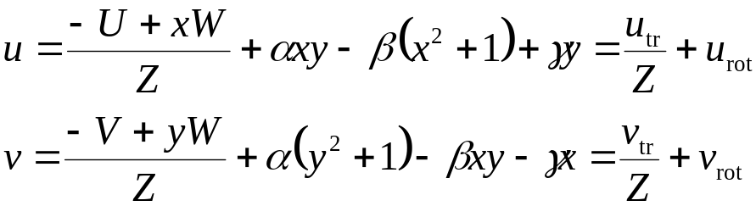
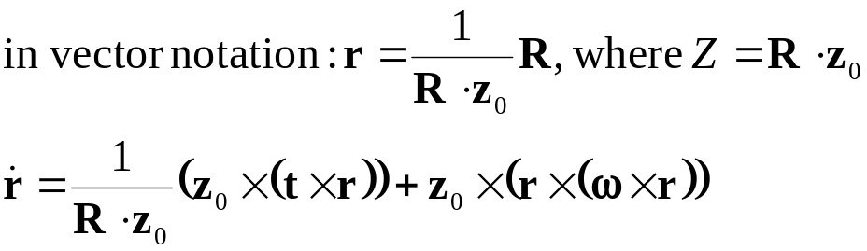
Image Flow due to Rigid Motion
The velocity of a point with respect to the XYZ coordinate system is
Scaling ambiguity: We can compute the translation only up to a scale factor (Kt, KZ) give the same flow as (t, Z).

Slide 17
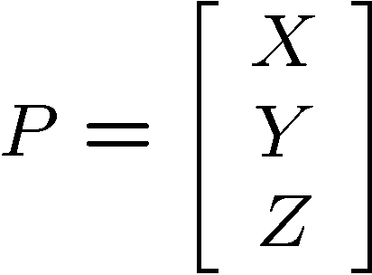
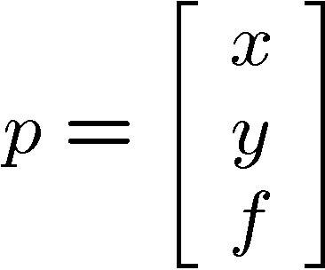
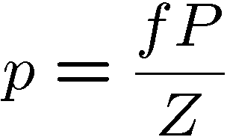
Consider a 3D point P and its image:
P
p
f
z
Z
Using pinhole camera equation:

Slide 18
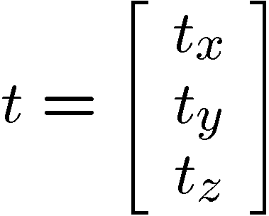
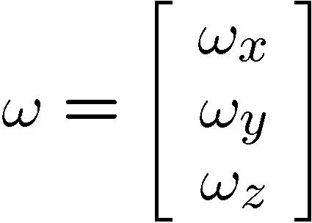
Let things move:
V
The relative velocity of P wrt camera:
P
v
p
Translation velocity
f
z
Rotation angular velocity
Z

Slide 19
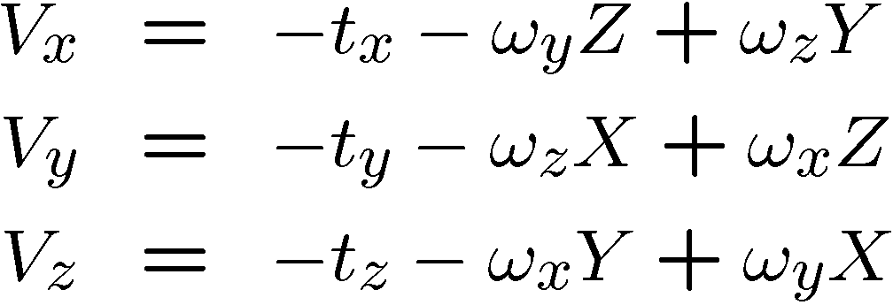
3D Relative Velocity:
V
The relative velocity of P wrt camera:
P
v
p
f
z
Z

Slide 20
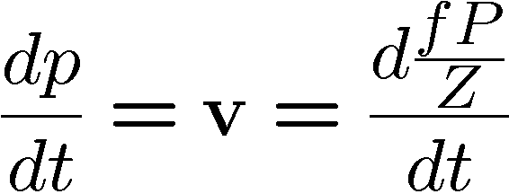
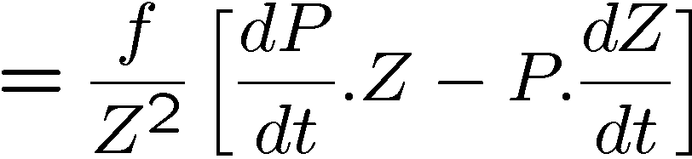
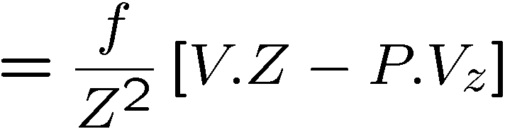
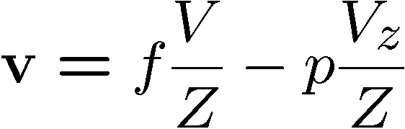
Motion Field: the velocity of p
V
P
Taking derivative wrt time:
v
p
f
z
Z

Slide 21
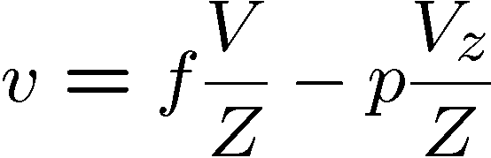
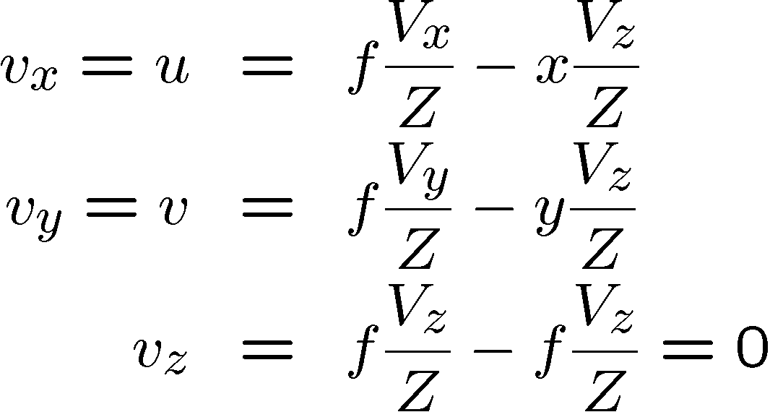
Motion Field: the velocity of p
V
P
v
p
f
z
Z

Slide 22
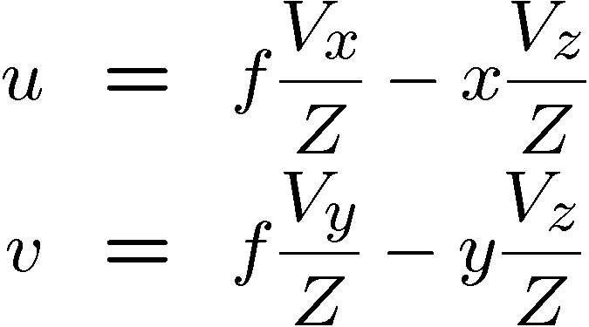
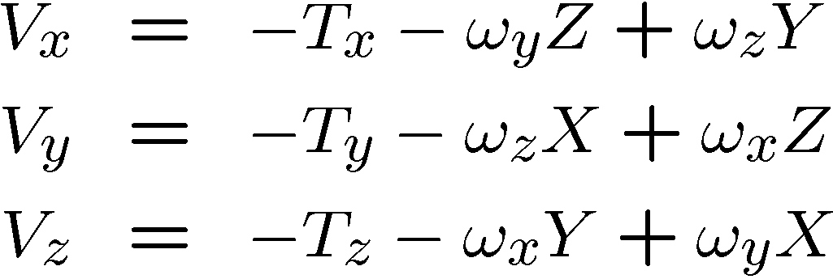
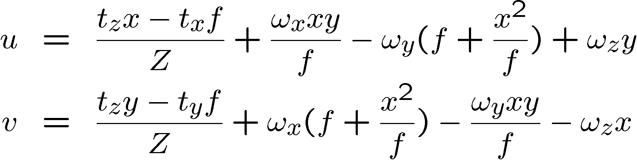
Motion Field: the velocity of p
V
P
v
p
f
z
Z

Slide 23
Motion Field: the velocity of p
V
Translational component
P
v
p
Scaling ambiguity
(t and Z can only
be derived up to a scale
Factor)
f
z
Z

Slide 24
Motion Field: the velocity of p
V
Rotational component
P
v
p
f
z
Z
NOTE: The rotational component is independent of depth Z !

Slide 25
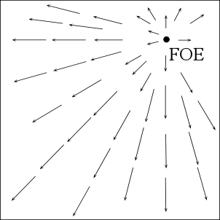
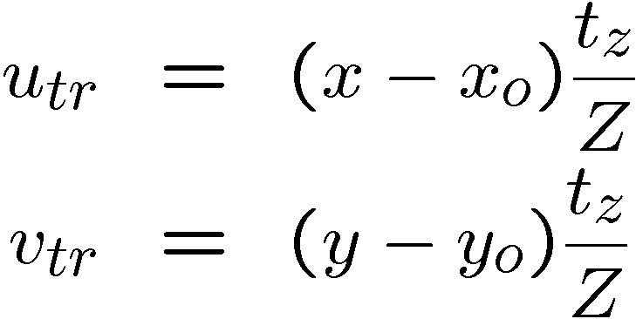

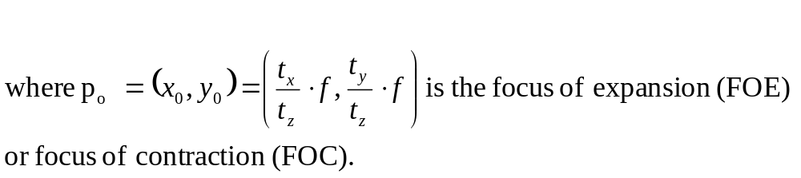
Translational flow field

Slide 26
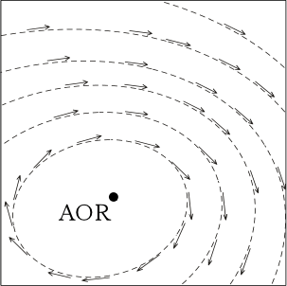
Rotational flow field

Slide 27
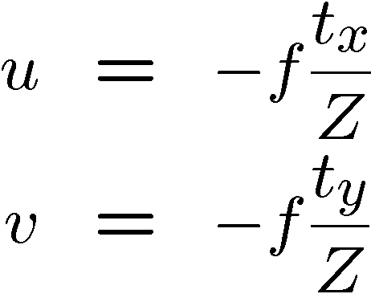
Pure Translation
What if t_{z} = 0 ?
All motion field vectors are parallel to each other and inversely proportional to depth !

Slide 28
Pure Translation:
Properties of the MF
If t_{z}≠ 0 the MF is RADIAL with all vectors pointing towards (or away from) a single point p_{o}. If t_{z} = 0 the MF is PARALLEL.
The length of the MF vectors is inversely proportional to depth Z. If t_{z} ≠ 0 it is also directly proportional to the distance between p and p_{o}.

Slide 29
Pure Translation:
Properties of the MF
p_{o} is the vanishing point of the direction of translation.
p_{o} is the intersection of the ray parallel to the translation vector and the image plane.

Slide 30
Special Case: Moving Plane
V
Planar surfaces are common in man-made environments
n
P
v
p
f
z
Z
Question: How does the MF of a moving plane look like?

Slide 31

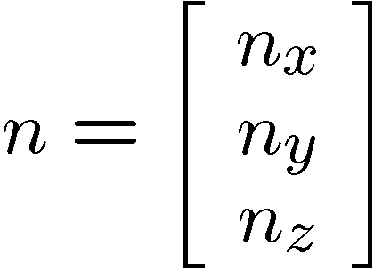
Special Case: Moving Plane
Points on the plane must satisfy the equation describing the plane.
Let
  n be the unit vector normal to the plane.
  d be the distance from the plane to the origin.
  NOTE: If the plane is moving wrt camera, n and d are functions of time.
X
n
d
P
Y
O
Z
Then:
where

Slide 32
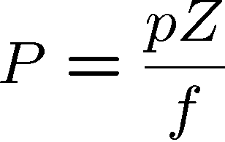
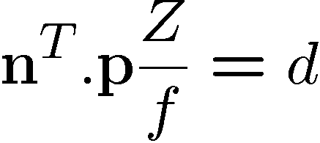

Special Case: Moving Plane
X
Let
be the image of P
n
P
Using the pinhole projection equation:
d
p
Y
O
Z
Using the plane equation:
Solving for Z:

Slide 33

Special Case: Moving Plane
X
Now consider the MF equations:
n
d
P
p
Y
O
Z
And Plug in:

Slide 34



Special Case: Moving Plane
X
The MF equations become:
n
d
P
p
Y
O
Z
where

Slide 35
Special Case: Moving Plane
X
MF equations:
n
d
P
p
Y
O
Z
Q: What is the significance of this?
A: The MF vectors are given by low order (second) polynomials.
  Their coeffs. a₁ to a₈ (only 8 !) are functions of n, d, t and ω.
  The same coeffs. can be obtained with a different plane and relative velocity.

Slide 36
Moving Plane:
Properties of the MF
The MF of a planar surface is at any time a quadratic function in the image coordinates.
A plane n^{T}P=d moving with velocity V=-t-ω£ P has the same MF than a plane with normal n’=t/|t| , distance d and moving with velocity
V=|t|n –(ω + n£ t/d)£ P

Slide 37
Classical Structure from Motion
Established approach is the epipolar minimization: The “derotated flow” should be parallel to the translational flow.
E
-u_{rot}
E
-u_{rot}
u_{tr}
u
u_{tr}
u
t

Slide 38






The Translational Case
(a least squares formulation)
Substitute back

Slide 39


Step 2: Differentiate with respect to t_{x}, t_{y}, t_{z}, set expression to zero.
Equations are nonlinear in t_{x}, t_{y}, t_{z}

Slide 40



Using a different norm
First, differentiate integrand with respect to Z and set to zero

Slide 41

where

Slide 42

Differentiate g( t_{x}, t_{y}, t_{z} ) with respect to t_{x}, t_{y}, t_{z} and set to zero
Solution is singular vector corresponding to
smallest singular value

Slide 43




The Rotational Case
Let f=1
In matrix form

Slide 44



The General Case
Minimization of epipolar distance
or, in vector notation

Slide 45
Motion Parallax
The difference in motion between two very
close points does not depend on rotation.
Can be used at depth discontinuities to obtain
the direction of translation.
FOE

Slide 46

Motion Parallax

Slide 47


Vectors perpendicular to translational component
Vector component perpendicular to translational component
is only due to rotation rotation can be estimated from it.

Slide 48

Motion Estimation Techniques
Prazdny (1981), Burger Bhanu (1990), Nelson Aloimonos (1988), Heeger Jepson (1992):
Decomposition of flow field into translational and rotational components. Translational flow field is radial (all vectors are emanating from (or pouring into) one point), rotational flow field is quadratic in image coordinates.
Either search in the space of rotations: remainig flow field
should be translational. Translational flow field
is evaluated by minimizing deviation from radial field:
.
Or search in the space of directions of translation: Vectors
perpendicular to translation are due to rotation only

Slide 49
Motion Estimation Techniques
Longuet-Higgins Prazdny (1980), Waxman (1987): Parametric model for local surface patches (planes or quadrics) solve locally for motion parameters and structure, because flow is linear in the motion parameters
(quadratic or higher order in the image coordinates)

